Slide 1

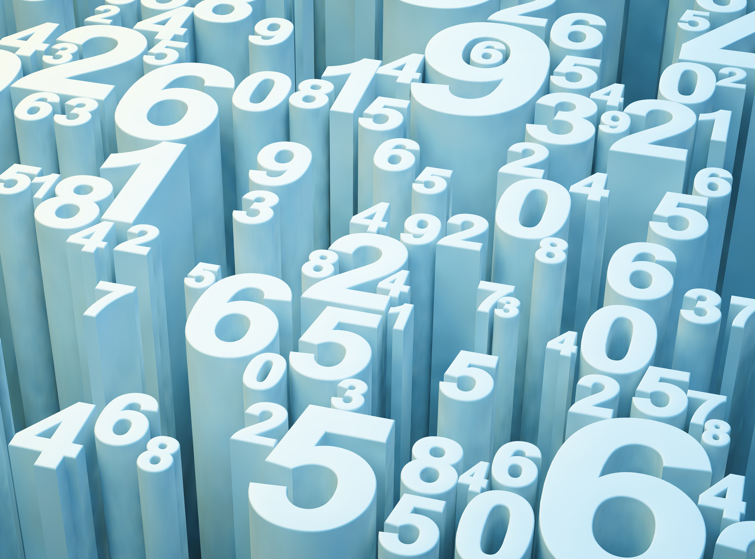

R for Business Analytics
Rushikesh Ranade MBA Business Analytics Brock University

Slide 2
Objective
Get familiar with R language
Learn basics of R
Prediction model in R
Time series analysis in R

Slide 3
R for Business Analytics
Data Wrangling
dplyr
sqldf
Visualization
ggplot2
plot_ly
Modelling
lm ts

Slide 4
Introduction to R
Install R software and CRAN
Introduction to Rmarkdown
Introduction to R Packages
Install first R Package
Load library
Introduction to Data Frame
Introduction to R variables

Slide 5

Let’s Dive into Code

Slide 6
Resources
Insurance data set
https://condor.depaul.edu/jlee141/econdata/eco520/
Download R
https://mirror.rcg.sfu.ca/mirror/CRAN/
Download R Studio
https://rstudio.com/products/rstudio/download/
CRAN Packages

